Slide 1
(SEI) Capability Maturity Model (CMM)

Slide 2
(SEI) Capability Maturity Model (CMM)
The Software Engineering Institute (SEI) Capability Maturity Model (CMM) specifies an increasing series of levels of a software development organization. The higher the level, the better the software development process, hence reaching each level is an expensive and time-consuming process.

Slide 3
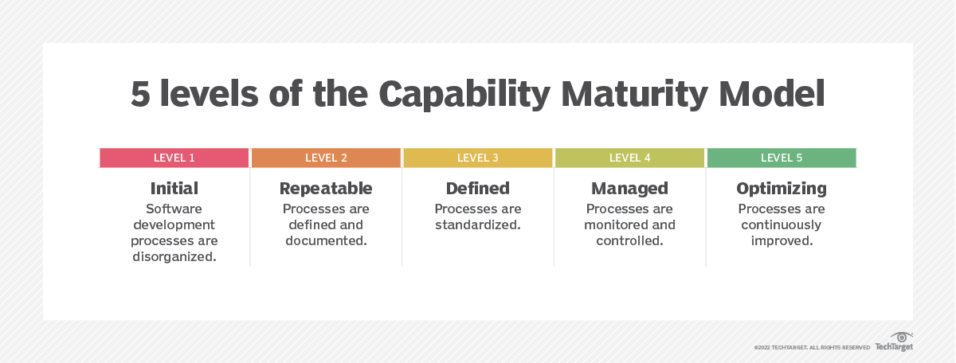

Slide 4
Initial.: At the initial level, processes are disorganized, ad hoc and even chaotic. Success likely depends on individual efforts and is not considered to be repeatable. This is because processes are not sufficiently defined and documented to enable them to be replicated.
Repeatable. At the repeatable level, requisite processes are established, defined and documented. As a result, basic project management techniques are established, and successes in key process areas are able to be repeated.
Defined. At the defined level, an organization develops its own standard software development process. These defined processes enable greater attention to documentation, standardization and integration.
Managed. At the managed level, an organization monitors and controls its own processes through data collection and analysis.
Optimizing. At the optimizing level, processes are constantly improved through monitoring feedback from processes and introducing innovative processes and functionality.

